Slide 1
DATA 601 Concluding Remarks
UMBC Data 601
Instructor: Felix Gonzalez
fgonzale@umbc.edu

Slide 2
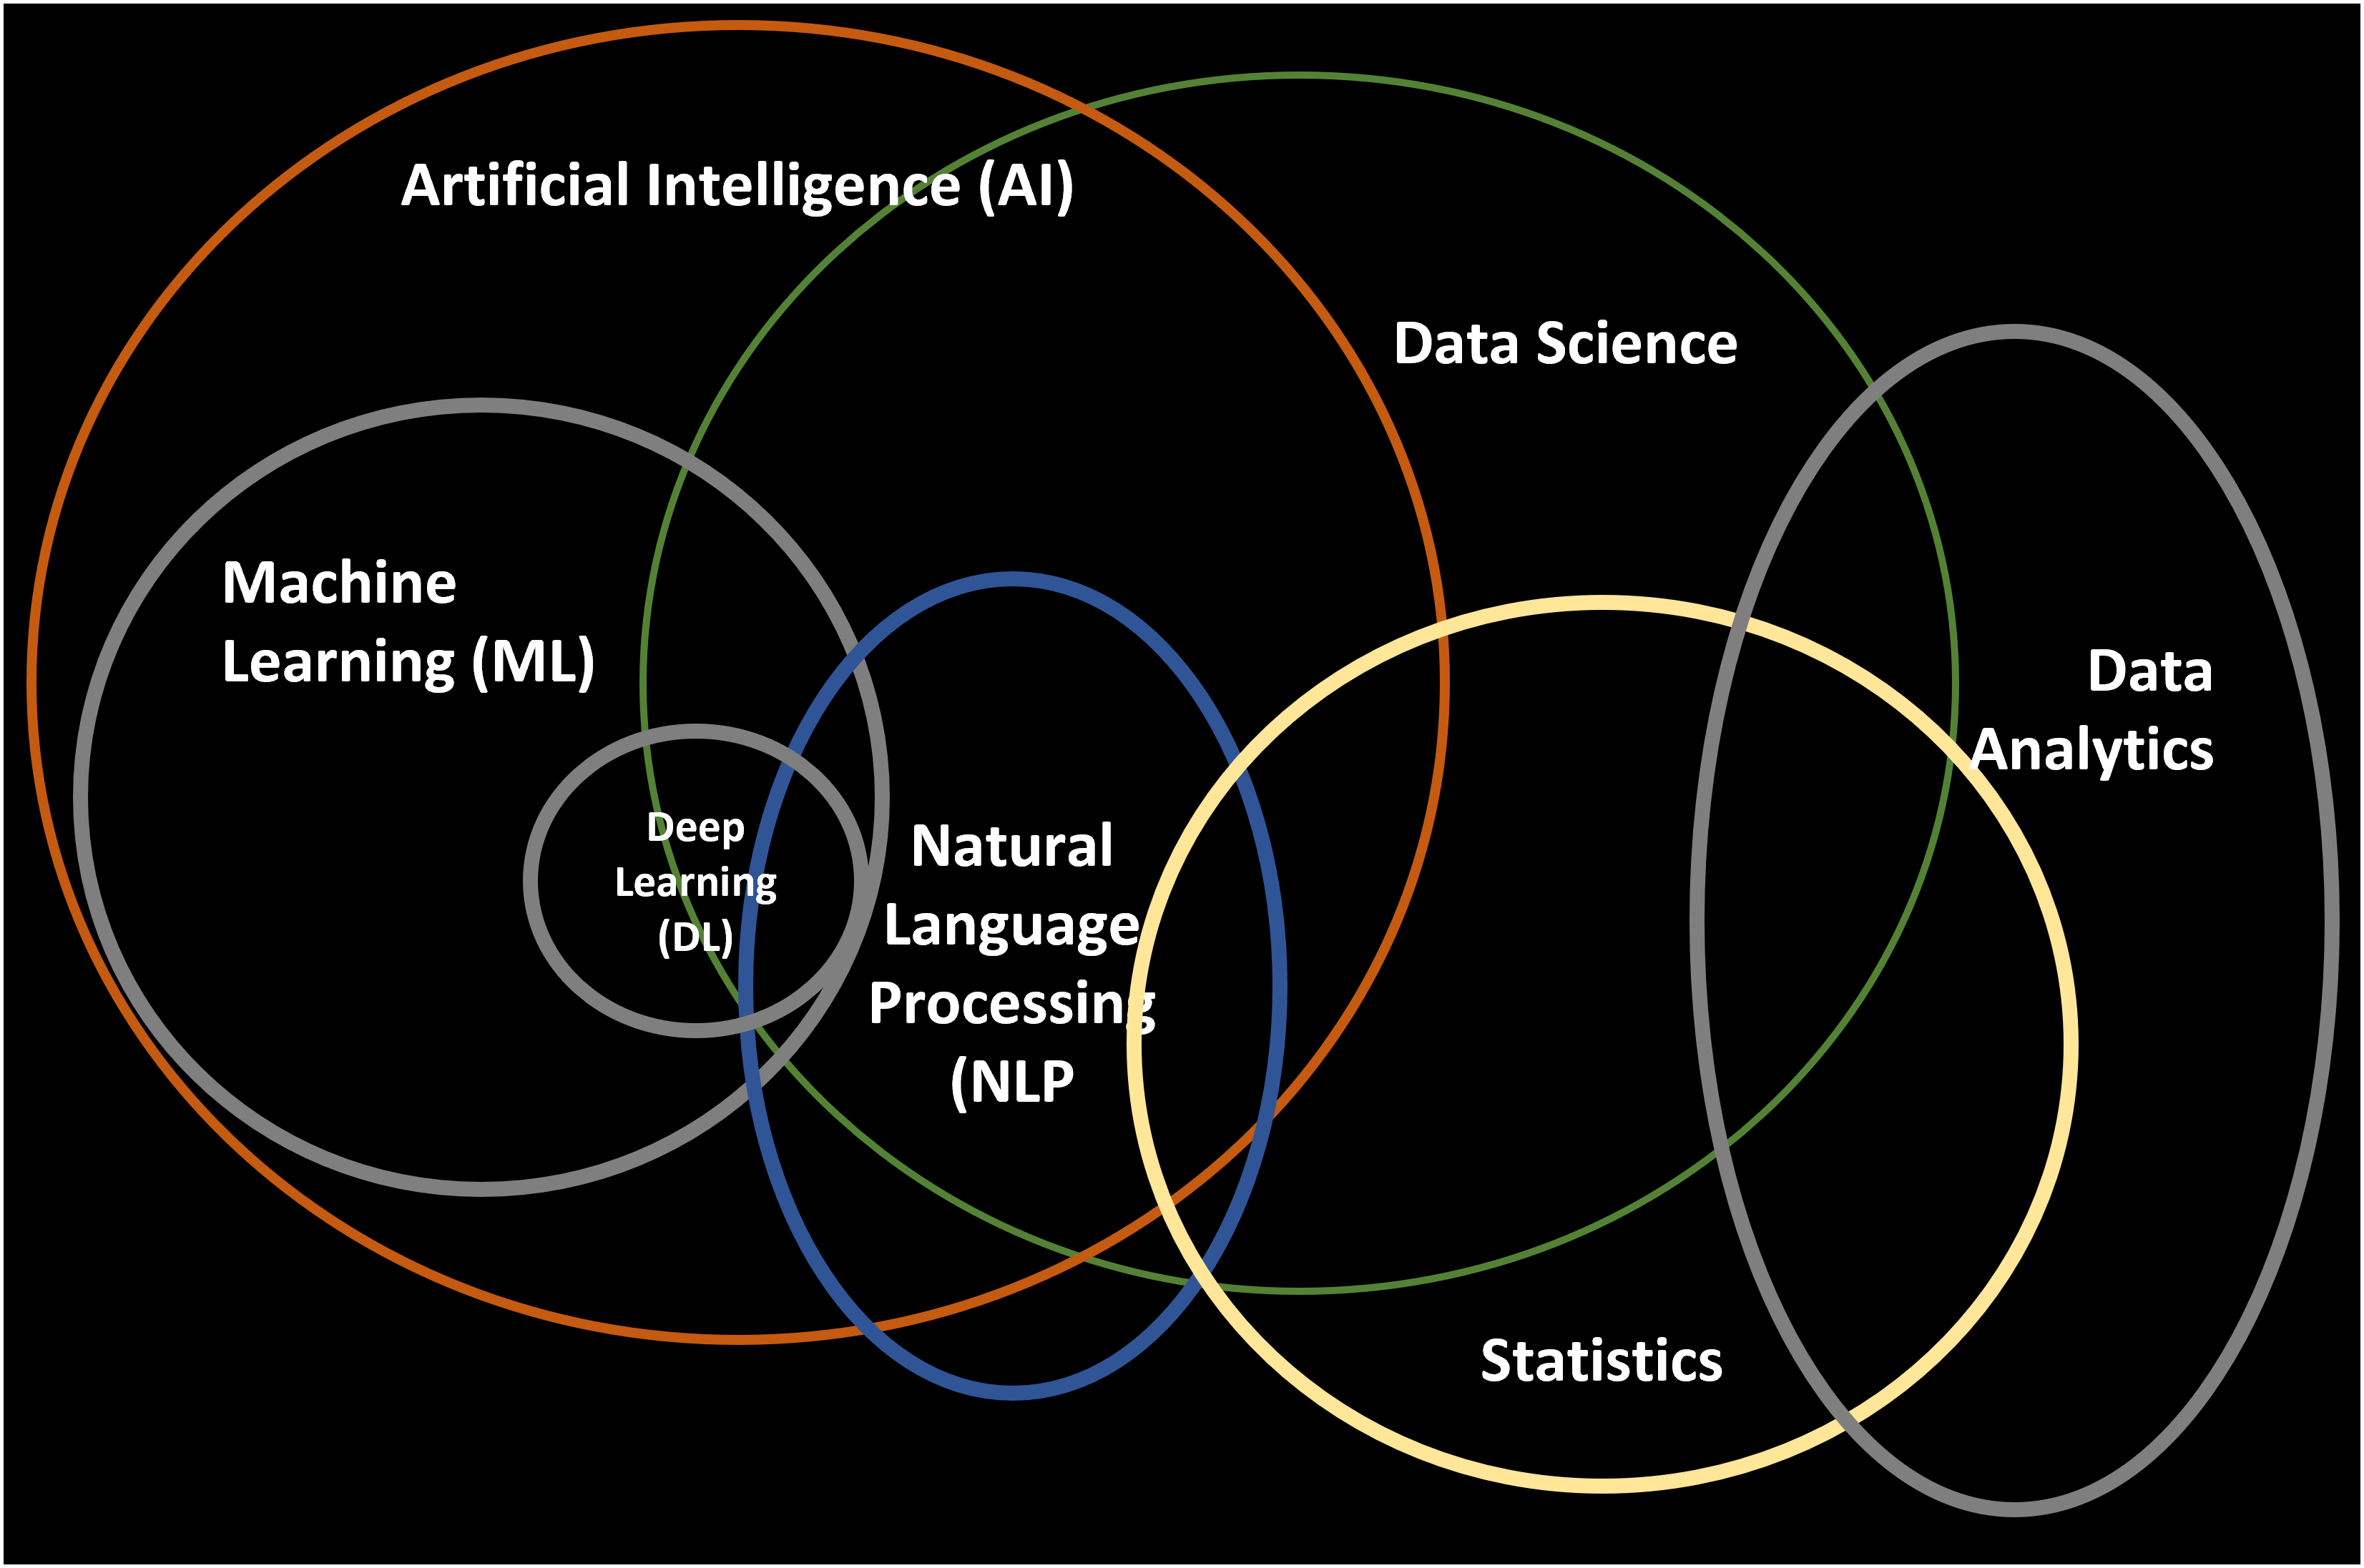
What is Data Science?

Slide 3
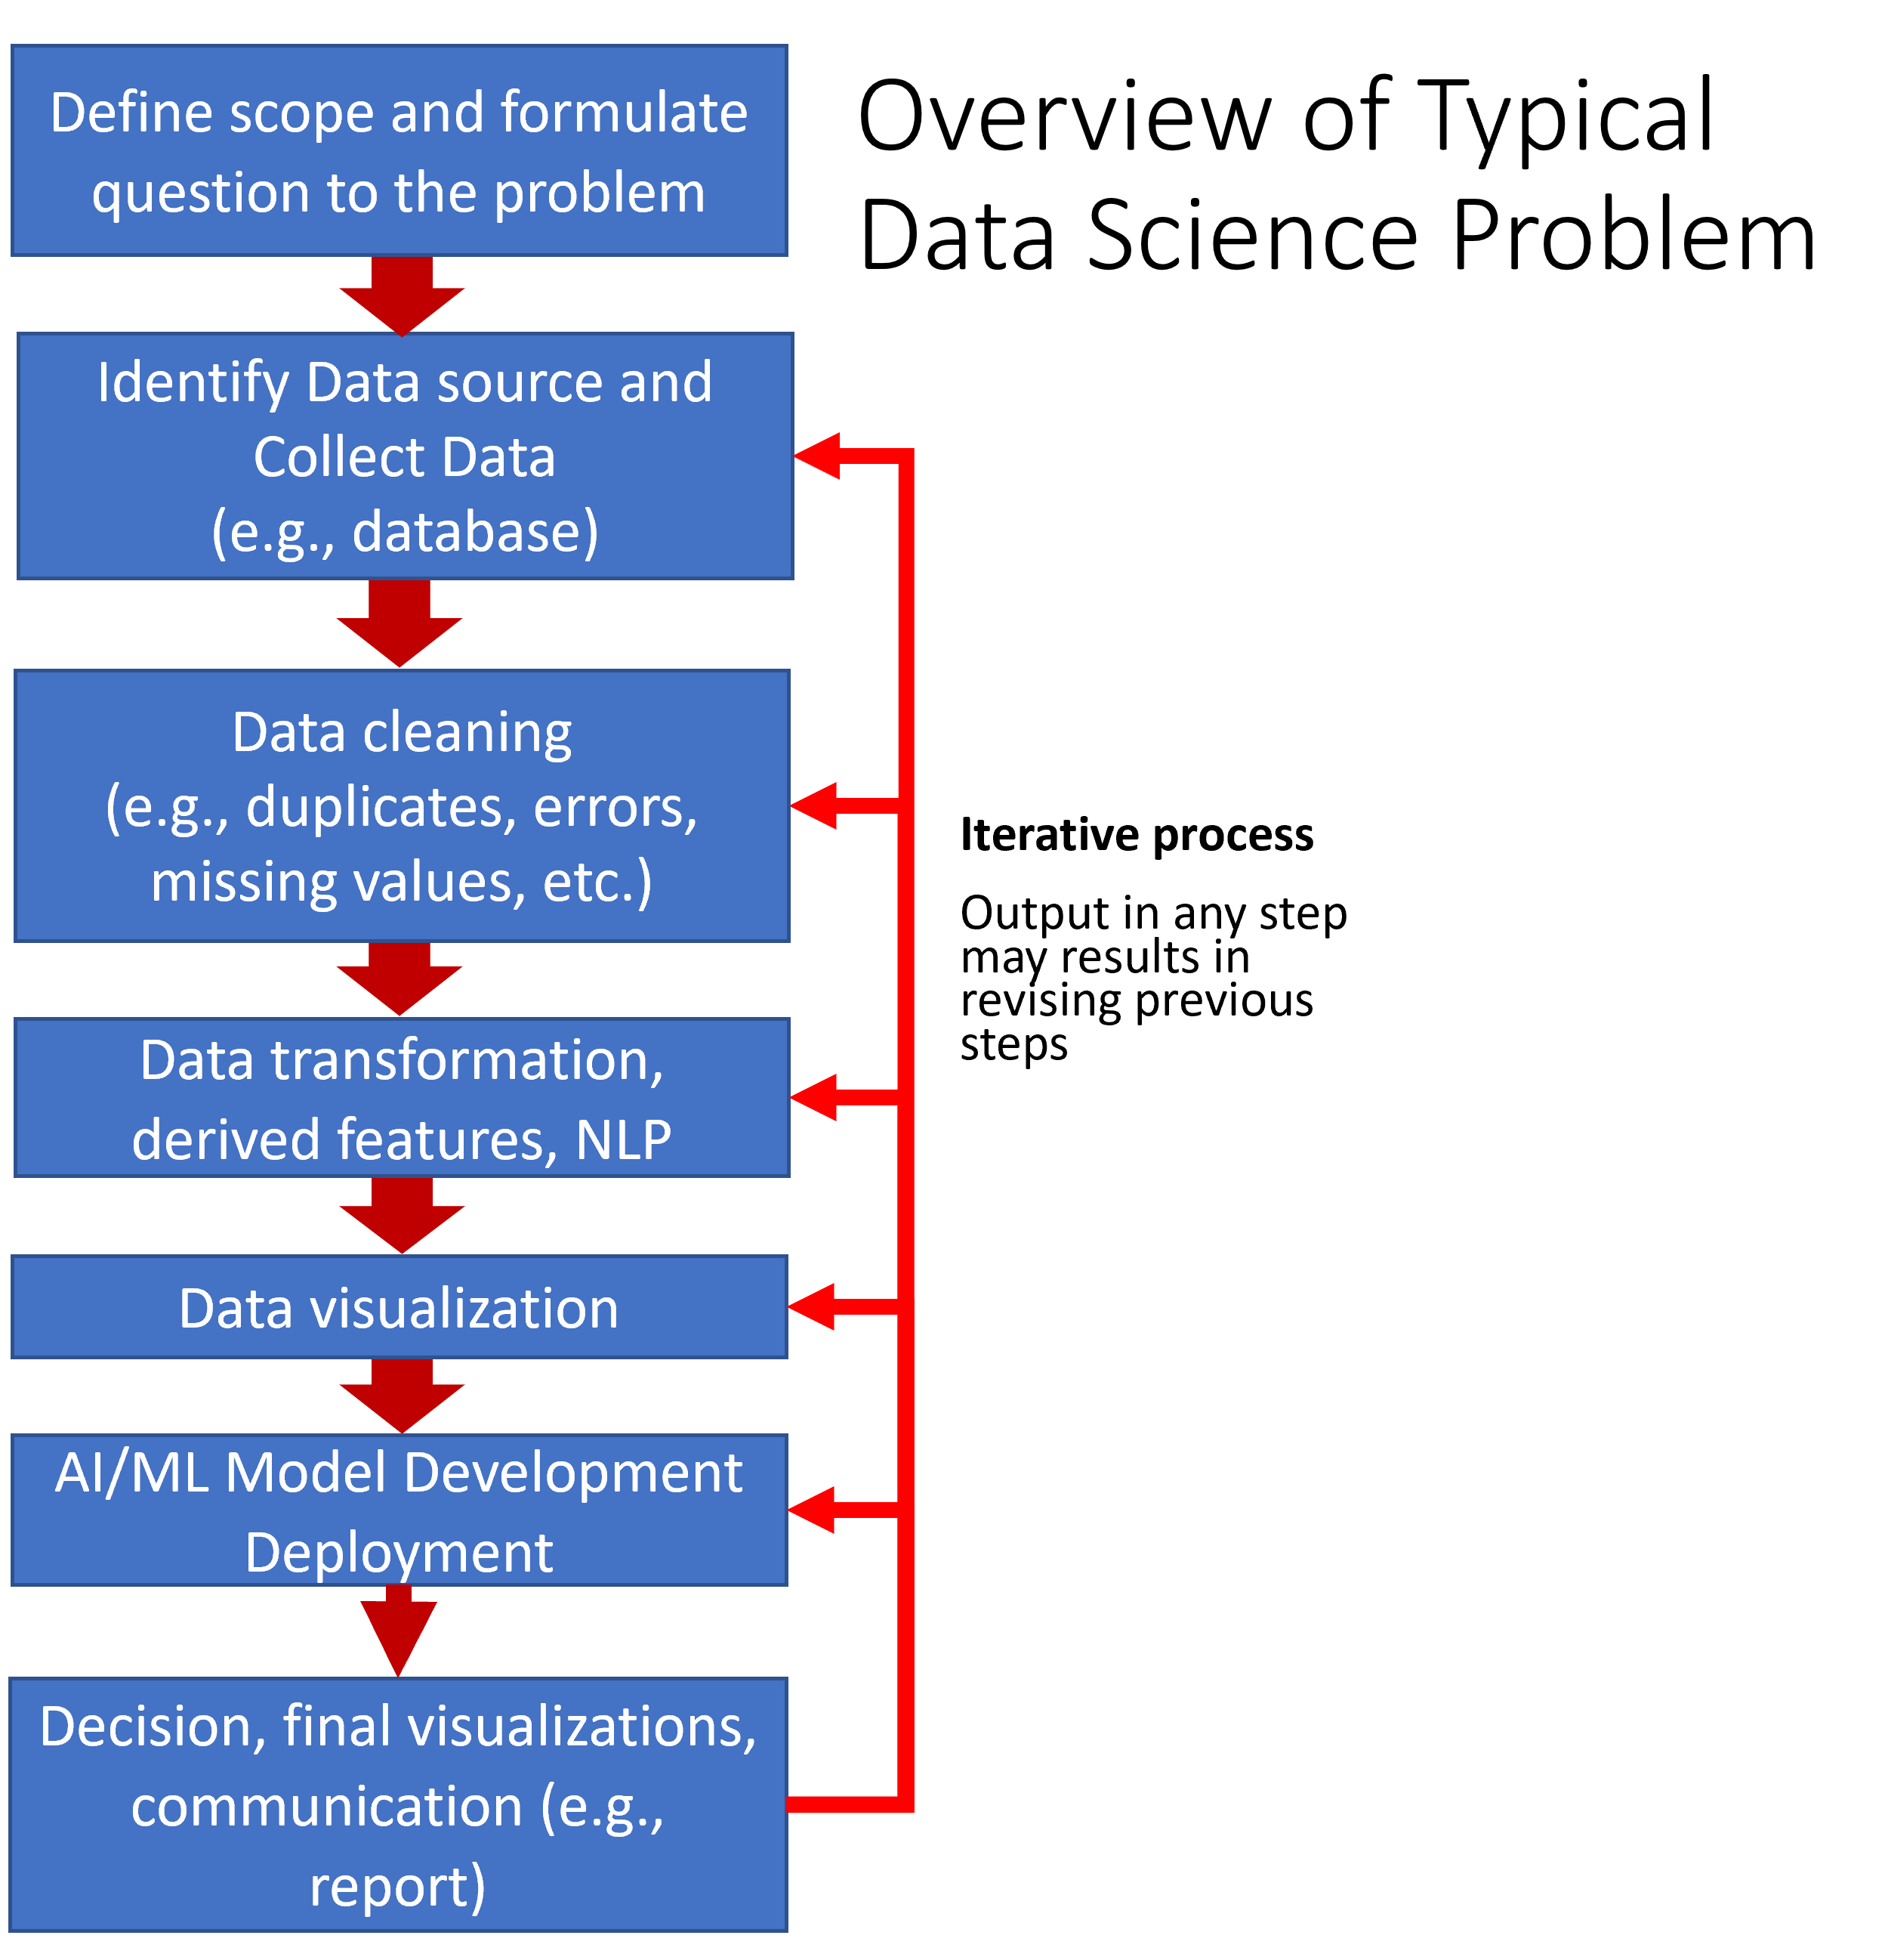
Data Science Process
Notes:
Many of the terms in this slide are often used interchangeably, their definitions can vary from various data analytic and data science commercial tools and frameworks and have various levels of overlap. We will talk about these during the class.

Slide 4
Future Reading

Slide 5
Tools and Platforms
Tools often have a combination of capabilities (e.g., visualization, AI, ML, NLP, etc.). Examples of readily available tools:
Open source (e.g., Python, R, Jupyter, JSD3, etc.)
Example of data analytics and data science platforms all with different capabilities, limitations, and learning curves:
Anaconda (Data science distribution package Python/R/Jupyter)
NVIDIA Deep Learning Institute (DLI)/Data Science Libraries (e.g., RAPIDS)/Omniverse
Google Cloud Services Platform
Amazon Web Services
MicroStrategy
MS Power Apps/Power Bi/Azure
Tableau
Hadoop
Palantir Foundry
SkySpark
PNNL Inspire (text analysis)
Low code or no-code development platforms
Jargon can vary from company to company from tools to tools.

Slide 6
Approaches and Datasets Resources
Title | Description | Link | Comment
Github | Used by many developers to share code and collaborate. | https://github.com/ | Class code is hosted in this website.
Kaggle | Host data science competitions, datasets, Jupyter notebooks, etc. | https://www.kaggle.com/ | Good source for datasets and Jupyter Notebooks.
Google Research Data | Google Dataset Search Engine | https://datasetsearch.research.google.com/ | Search engine for datasets. May send you to data in other websites.
Medium and Towards Data Science | Short articles on data science, data analysis, AI, ML, NLP, and other related topics. | https://medium.com and https://towardsdatascience.com | Articles are not peer reviewed.
Conference Papers and Peer Reviewed Journals | Peer reviewed journals on data science, data analysis, AI, ML, NLP and other related topics | No specific recommendation as recommendation may vary by topic. | Most authoritative source of information along with published books.

Slide 7
Visualization Examples Resources
Title | Description | Link | Comments
MatPlotLib Example Gallery | Python Plotting Library | https://matplotlib.org/stable/gallery/index.html | Library included in Anaconda.
Seaborn Example Gallery | Python Plotting Library | https://seaborn.pydata.org/examples/index.html | Library included in Anaconda.
Anaconda Panel App Gallery | Anaconda Panel Dashboard Examples | https://panel.holoviz.org/gallery/index.html | Library included in Anaconda.
Bokeh Gallery | Bokeh Dashboard Examples | https://docs.bokeh.org/en/latest/docs/gallery.html | Library included in Anaconda.
Plotly Example Gallery | Python Plotting Library | https://plotly.com/python/ | Library included in Anaconda.
D3.JS | Data Driven Documents Visualization Library | https://d3-graph-gallery.com/ | Used to deploy dynamic website plots.
Five Thirty Eight | Interactive Dashboard Examples | https://projects.fivethirtyeight.com/ | Excellent Website that provides great examples on the capabilities of dashboards and data analytic visualizations.

Slide 8
Important Topics
Data cleaning, preparation, wrangling, transformation
Working with data (e.g., integers, floats, text, dates, categorical, lists, arrays, dictionaries, data frames)
Data augmentation, synthetic data, data pipelines, algorithm and data bias, data balance
Exploratory data analysis and data visualization
Statistics
Time series
Machine Learning (ML),
Supervised ML (e.g., train, test, split, sampling, fitting, predicting)
Regression
Classification (e.g., binary, multi-class, multi-label)
Unsupervised ML Clustering (e.g., kmeans, DBSCAN)
Model performance evaluation, metrics and related topics:
Model underfitting and overfitting
Accuracy, precision, recall, F1 score, confusion matrix
Natural language processing (e.g., text normalization, similarity ranking, text classification, text clustering)
Feature selection
Dimensionality reduction (e.g., PCA, TSNA)
Dashboarding and user interface design
Ethics (e.g., fairness, security, privacy, civil rights)
Version control and environment freezing
Deployment (e.g., in cloud service, docker and containers)
Communications of results

Slide 9
Other Topics
Latent Dirichlet Allocation (LDA)
Model optimization and hyperparameter tunning
Ensemble Learning (i.e., merging prediction from multiple models) (e.g., ensemble models, bagging, boosting, stacking)
Deep learning (e.g., transformers)
Reinforcement learning
Word embeddings text models
Named entity recognition
Text sentiment analysis
Text summarization methods and models
Generative AI and large language models
Knowledge Graphs and Network Analysis

Slide 10
Thank You!!!

